Slide 1

TradeTrendz
Alex, Neya, Shadrack
FinTech 2023

Slide 2
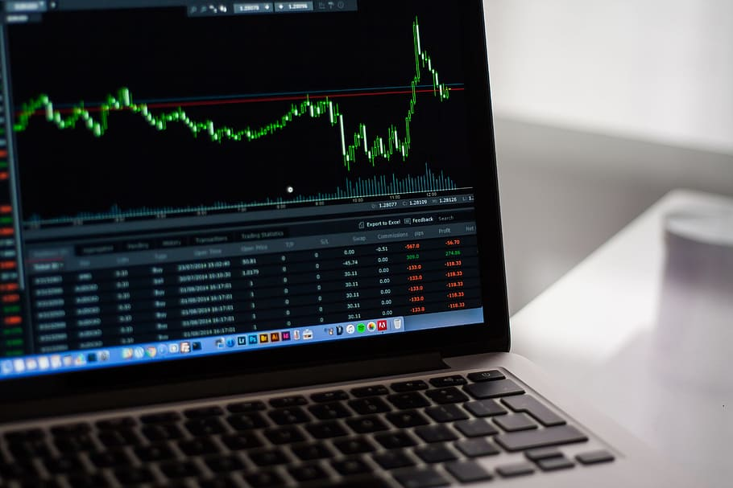
Do you have time to watch the stock market all day hoping it will move in your favor?

Slide 3

Our Motivation – No hands attached profit!
Trends to predict the stock price.
Models to access the efficiency.
Breakouts that allows stock selection for your type of trade Buy or Sell:
Stocks
Options
An App to make it Seamless!
This Photo by UnknowAuthor is licensed under CC BY-NC

Slide 4

Alex
Trade Algorithim
Technologies used

Slide 5

Alex
Challenges – Insert Challenges
Successes – Insert Success, Summary of outcome

Slide 6

Shadrack Random Forest Model

Slide 7

Shadrack N.
Challenges – Insert Challenges and/or snippets
Successes – Insert Success, Summary of results

Slide 8

Neya
Stock Selector
Group input on technical indicators.
XGBoost Model

Slide 9
Neya
Challenges – Trying to receive the next day stock price for XGBoost model.
Successes – Received High Accuracy on XGBoost Model

Slide 10

Summary:
No emotions attached.
Minimize risk.
Removes the need to Date our stocks.
This Photo by Unknown Author is licensed under CC BY-SA

Slide 11
Further advance in the future….
Random forest with …
Algo will continue to perform well – ML model .
Run through the algo… stock selector. ML Random
ML
App
ReadMe

